Slide 1
The Work of Jacques Bertin and Data Visualization
Justin Joque
University of Michigan
November 4, 2021

Slide 2
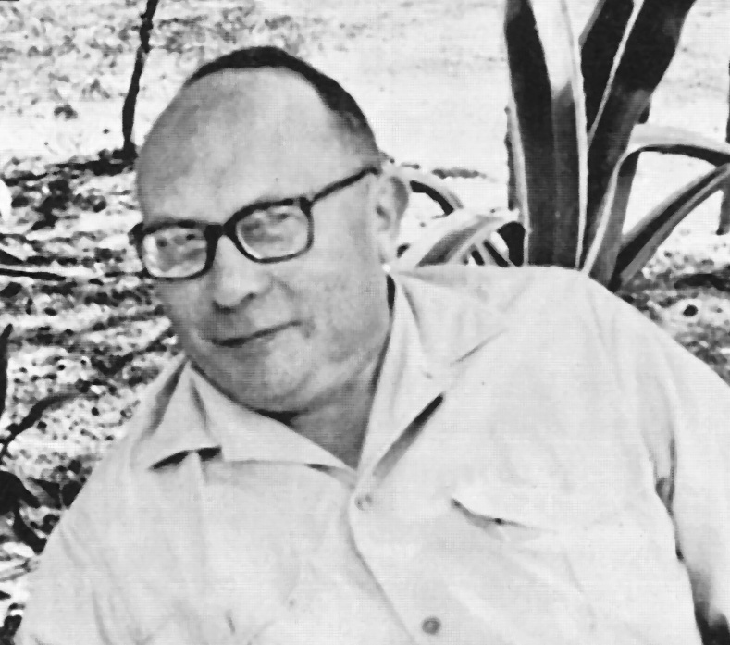

Slide 4
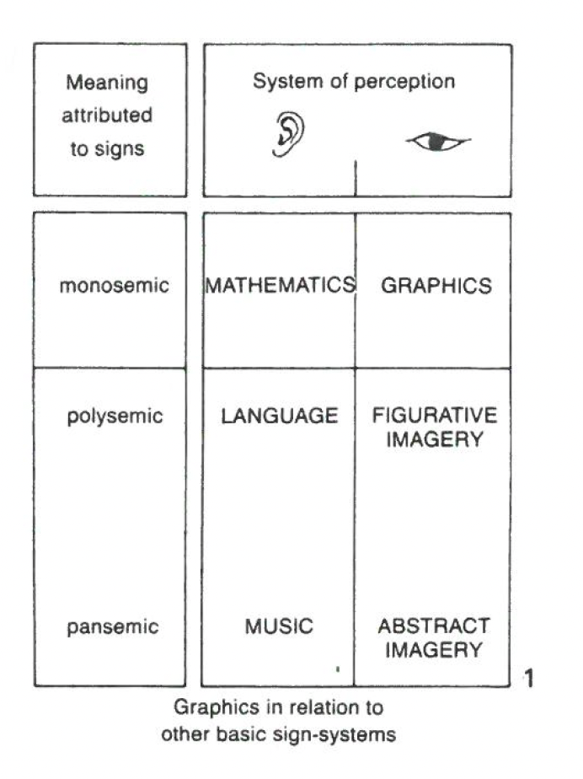

Slide 5
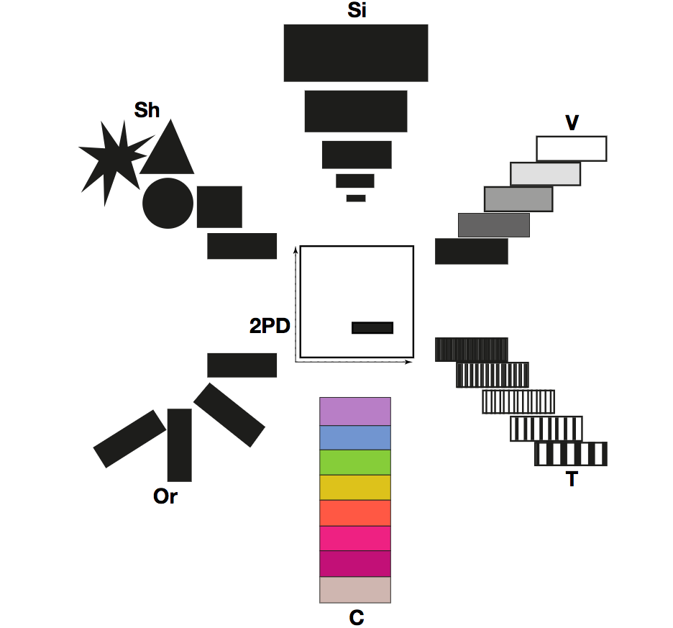

Slide 6
